Slide 1
CX1104 Part 2 for 2025/2026 (S1)
Chng Eng Siong
Email: aseschng@ntu.edu.sg
Last updated: Oct 2025

Slide 2
Content
How will we conduct the course
Suggested study schedule for online video
Quiz 2 announcement

Slide 3
1) How will we conduct the course?
Watch the videos (youTube) according to the schedule (pg 4) for lectures/tutorials
a) Recommend you to download videos (slide 8) b) or use AdBlockers to remove adverts
During the online lecture
we will summarize the lectures,
Q&A.
You can use Matlab to check your answers: Installation Instruction: https://libfaq.ntu.edu.sg/faq/267969 (you must be in NTU network) - How to use Matlab(Brunton): https://www.youtube.com/watch?v=U9EL8-9MuYA
- Matlab is not tested in the exam.

Slide 4
Teams link for online lecture (2025/26 S2) week 8~13
Monday: Week 8~13: 4.30~5.30pm Microsoft Teams Need help?
Join the meeting now
Meeting ID: 478 915 592 265 2
Passcode: s8a2MY6A
Friday: Week 8~13: 8.30~10.30am Microsoft Teams Need help?
Join the meeting now
Meeting ID: 483 945 605 189 0
Passcode: J5Y3Z2CV
https://teams.microsoft.com/meet/4789155922652?p=yHP7G76UM4KB3U9v8X
https://teams.microsoft.com/meet/4839456051890?p=LM3BRPDAU3f9gyq4ZI

Slide 5
2) Online Video learning Schedule for Part 2
NTU Week | Part 2 Chapter ID | Topics | Duration of recorded Videos (appr) | Tutorial Schedule
8 | 6 | Orthogonality, Orthogonal Projection, Basis. | 4hr 20min | None
9 | 7 | Least Squares and Normal Eqn, Projection Matrix, Applications | 2 hours | T6 (Orthogonality)
10 | 8A.1, 8A.2 | Complex Numbers: Intro+ DeMoivre Theorem | 2 hours | T7 (Least Squares)
11 | 8A.3 | Complex Number: DFT, | 2 hours | T8A (Complex Numbers)
12 | 8 | Eigenvectors, Eigen-values, Diagonalisation, Power of A, Change of basis | 3 hours | T8A and T8 (EigenVectors)
13 | 9.1.1-9.1.4 | SVD Introduction – Ch 9 not in this exam (2025/26 S1) Quiz |  | T8 (EigenVectors)
Link: https://www.youtube.com/@linearalgebra1884

Slide 6
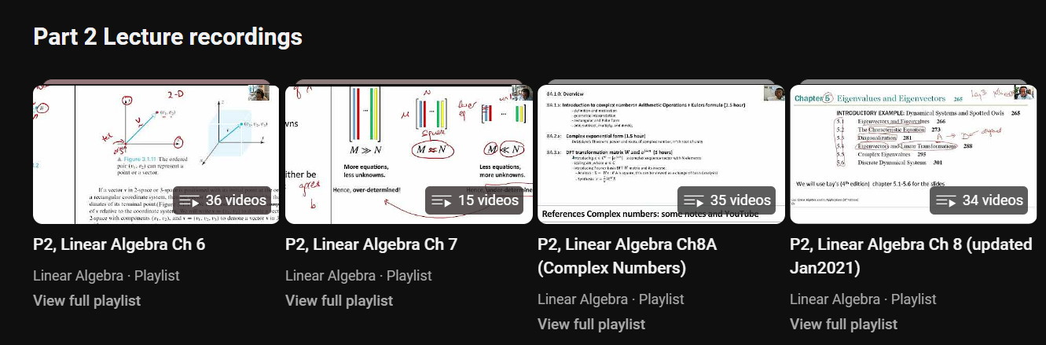
YouTube Recordings: 4 chapters Ch 6,7,8A, 8
Link: https://www.youtube.com/@linearalgebra1884

Slide 7
3) Quiz 2 and Exam announcement
Quiz 2: proposed date: week 13 - TBD
Quiz 2’s Absentee: No ReQuiz. See Prof Deepu’s email regarding absentees.

Slide 8
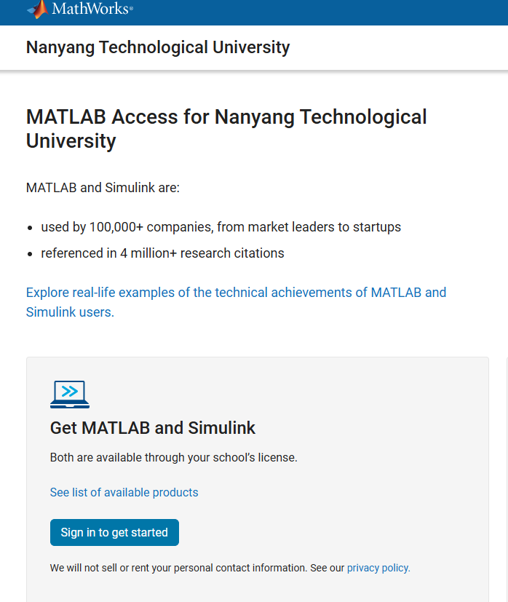
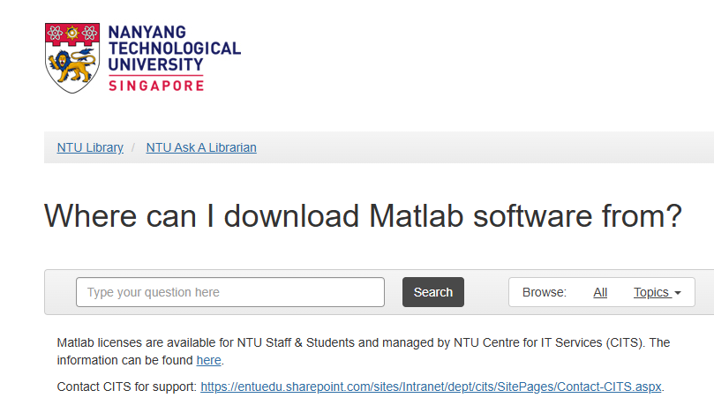
Instructions to Install MATLAB for NTU
https://www.mathworks.com/academia/tah-portal/nanyang-technological-university-31272985.html
https://libfaq.ntu.edu.sg/faq/267969

Slide 9
Instructions to use yt-dlp to download from youTube the recordings

Slide 10
Contact
If you need to contact me, pls send me email (using NTU email) clearly stating
Who are you, which class/which subject (as I teach multiple courses), whats the issues, and what do you need.
For tutorial matters, pls approach your tutor first.
Thank you. Eng Siong

